Slide 1
Opening
List 1 reasons why teens begin using tobacco.
What is nicotine?
List two types of smokeless tobacco

Slide 2
Teens and Tobacco
Lesson 2

Slide 3
Lesson Focus
Identify factors that influence teens to try tobacco.
Recognize negative influences on teens to use tobacco.
Access reliable information on teens and tobacco use.

Slide 4
Animoto
http://animoto.com/play/CCWcxUIE8vVQfTZqAltbzA

Slide 5
Vocabulary
Negative peer pressure Pressure you feel to go along with harmful behaviors or beliefs of your peers.
Media The various methods of communication information, including newspapers, magazines, radio, television, and the internet.

Slide 6
Facts about teens and tobacco pg. 227
Inaccurate beliefs about tobacco use may be responsible for the fact that every day, 4000 young people try their first cigarette.

Slide 7
Some Teens Believe pg. 228
Smoking makes a person look cool.
Tobacco makes teens more accepted among their peers.
Using tobacco makes teens seem more grown up.
Tobacco won’t hurt your health for many years.

Slide 8
In Reality pg. 228
Tobacco stains teeth, leads to bad breath, and causes wrinkled skin.
Between 70 and 80 percent of teens have never tried tobacco. Teens who us tobacco are also more likely to get in fights, carry weapons, and use alcohol and other drugs.

Slide 9
In Reality pg. 228
The number of adult tobacco users is on the decline.
Some of tobacco’s effects begin with the first use. Tobacco use is habit-forming. Once a person starts using tobacco, it can be very difficult to quit.

Slide 10
Negative Peer Pressure pg. 228
Negative peer pressure Pressure you feel to go along with harmful behaviors or beliefs of tour peers.

Slide 11
Media pg. 228
The media is another negative influence.
Media The carious methods of communicating information, including newspapers, magazines, radio, television, and the internet.
Tobacco use is glamorized in many movies and pop songs.

Slide 12
Tobacco Advertising Activity
Advertisers are attempting to target teens with “point-of-sale promotions, giveaways, and internet advertising intended for teens.
When I show the picture, describe how advertisers are targeting teens.

Slide 13

Advertisement 1

Slide 14
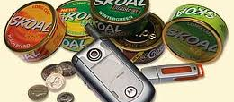
Advertisement 2

Slide 15
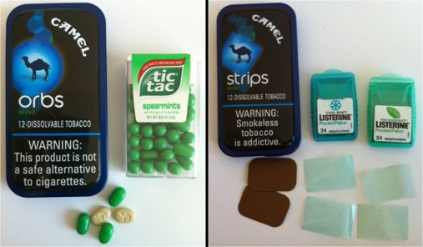
Advertisement 3

Slide 16
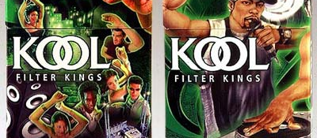
Advertisement 4

Slide 17
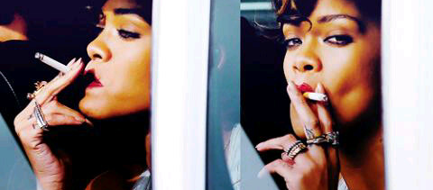
Advertisement 5

Slide 18

Advertisement 6

Slide 19
Advertisement
Think about how a cigarette advertisement depicts tobacco use. How might it influence a teen’s behavior?

Slide 20
Letter to a Tobacco Company
Write a four paragraph(20 sentences) letter to a tobacco company. In this essay (1st paragraph)explain why their products are so harmful. (paragraph 2) explain why it is not a smart decision to try cigarettes even once. (Paragraph 3) Talk about two long term effects of tobacco products. (Paragraph 4) talk about two short term effects of tobacco usage. (You can use your notes)

