Slide 1
Warm Up:
Please list three facts you learned yesterday that you did not know previously.

Slide 2
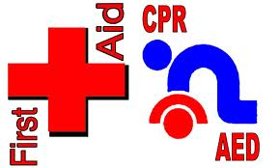
Unit 1
First Aid & CPR
Follow along with the crossword and take notes on the back!

Slide 3
1. ACROSS
The immediate care given to someone who becomes injured or ill until regular medical care can be provided.
FIRST AID
Knowing first aid may help you deal with some emergency situations!

Slide 4
Poll Everywhere

Slide 5
2. ACROSS
A first aid procedure to restore breathing and circulation.
CPR
cardiopulmonary resuscitation
CPR should only be performed by someone who has been trained and certified to perform the procedure.

Slide 6
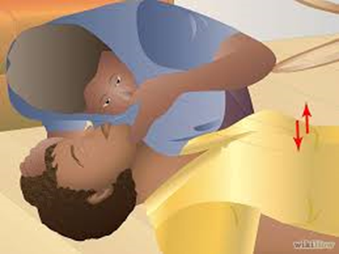
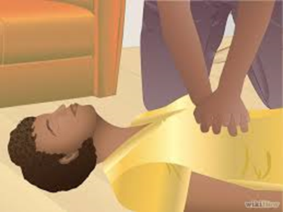
CPR involves several steps including:
Checking the scene.
Checking the victim.
Call for help.
Check for breathing
Start CPR by performing 30 chest compressions followed by 2 rescue breaths.
If the heart stops beating, the flow of blood to the brain stops. When the brain stops functioning, breathing also stops

Slide 7
3. DOWN
A first aid procedure where someone forces air into the lungs after each compression cycle of CPR.
RESCUE BREATH
Give two rescue breaths after each 30 compression cycle.

Slide 8
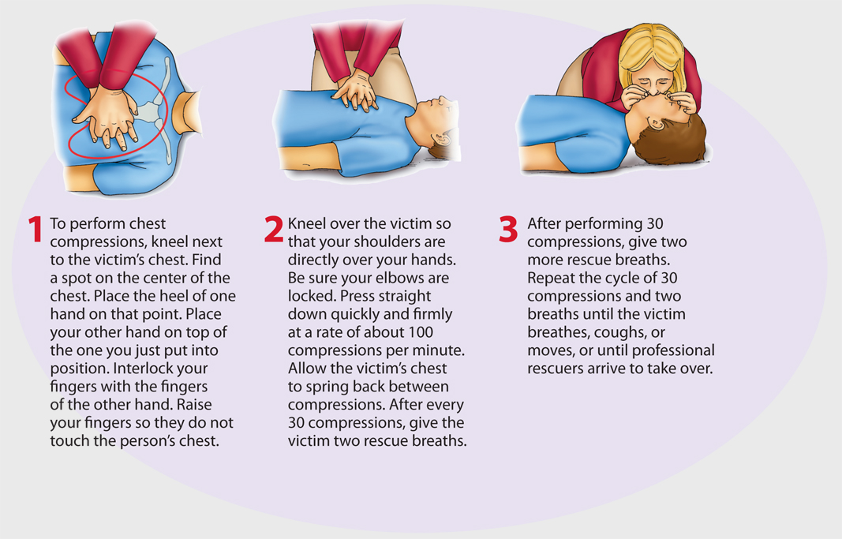
Performing the CPR Cycles

Slide 9
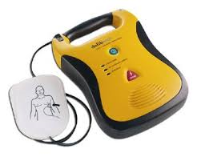
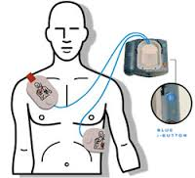
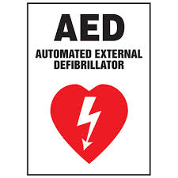
Automated External Defibrillators
An AED is used when a person’s heart stops beating.
An automated external defibrillator (AED) sends a quick jolt of electricity to the heart through the chest to make a heart start beating.
More and more public places keep AEDs on hand.

Slide 10
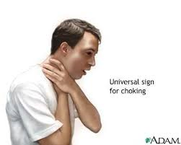
How to Help Someone Who is Choking
Choking results when a person’s airway becomes blocked by food or accidentally swallowed objects.
Signs of Choking:
Grabbing throat and neck
Gagging
Wheezing
Turning blue in the face

Slide 11
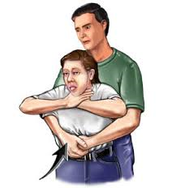
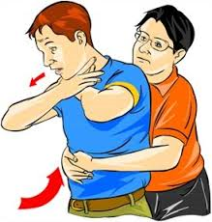
4. ACROSS
Quick inward and upward pulls into the diaphragm to force an obstruction out of the air way.
ABDOMINAL THRUSTS
For an adult or child who is choking, give them 5 aggressive pats on the back. If that does not dislodge the object, give 5 abdominal thrusts.

Slide 12
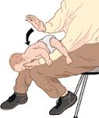
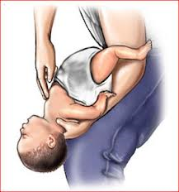
5. ACROSS
Quick presses into the middle of the breastbone to force an obstruction out of the air way.
CHEST THRUSTS
If an infant is choking, use a mix of back blows chest thrusts.

Slide 13
Warm-up – What do you do if someone is choking or is unconscious?
https://www.polleverywhere.com/multiple_choice_polls/ZIigaEX3veGIpvU

Slide 14
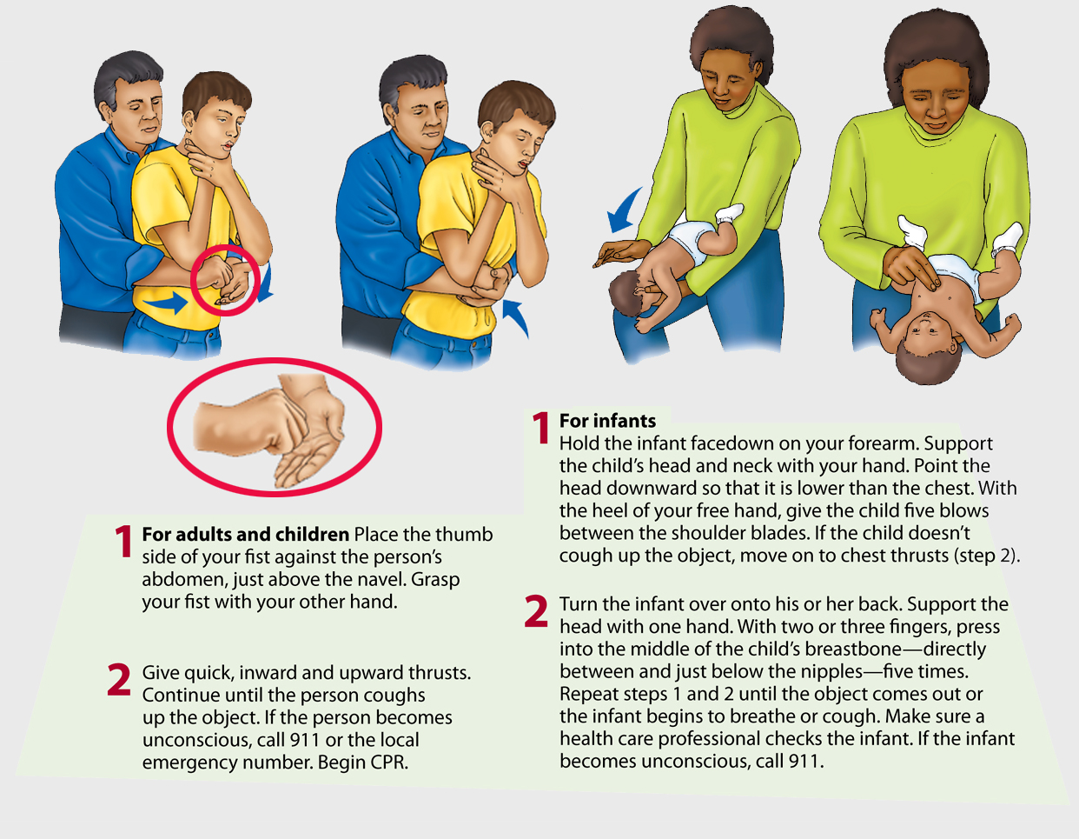

Slide 15
6. DOWN
A ________________ degree burn is when the outer layer of the skin has burned and turned red.
FIRST
Treatment
Treatment
Flush the burned area with cold water for at least 20 minutes.
Flush the burned area with cold water for at least 20 minutes.
Wrap the burn area in a
clean, dry dressing.
Wrap the burn area in a
clean, dry dressing.
DO NOT USE ICE!

Slide 16
7. DOWN
A ________________ degree burn is a moderately serious burn in which the burned area blisters.
SECOND
Treatment
Flush the burned area with cold water for at least 20 minutes.
Elevate the burned area.
Loosely wrap the cooled burn in a clean, dry dressing.
DO NOT POP BLISTERS!

Slide 17
8. DOWN
A ________________ degree burn is when all the layers of the skin are damaged.
THIRD
Treatment
Do not remove burned clothing.
Reduce the heat of the burned area and cover with a clean cloth.
Call 911 immediately.

Slide 18
How to Avoid Burns
Never play with matches or fire.
Handle hot foods carefully.
Avoid making the water too hot in the shower.
Use sunscreen and limit your time in the sun.

Slide 19
Warm Up:
Please explain the difference between abdominal thrusts and chest thrusts.
How many chest compressions and rescue breaths should you give while performing CPR?

Slide 20
9. ACROSS
A break in a bone.
FRACTURE

Slide 21
10. DOWN
A major injury that happens when a bone is forced from its normal position within a joint.
DISLOCATION
Moving a broken bone or dislocated joint could cause further injury.

Slide 22
Treating Sprains and Burns
P
Protect the injured part.
R
Rest the injured part.
I
Ice the injured part using an ice pack with a towel between the skin and ice (remove the ice every 15–20 minutes).
C
Compress the part with a bandage.
E
Elevate the part above the level of the heart.

Slide 23
How to Stop Severe Bleeding
Before you help someone who is bleeding, put on protective gloves.
Avoid touching someone else’s blood, if possible. Blood can contain pathogens.
Severe bleeding is a life-threatening emergency. Blood loss prevents oxygen from getting to the body’s organs.

Slide 24
How to Stop Severe Bleeding
Elevate the bleeding area so that it is above the level of the heart.
Cover the wound with sterile gauze or a clean cloth.
Once the bleeding slows or stops, secure the pad firmly in place.
Stay with the victim until help arrives.

Slide 25
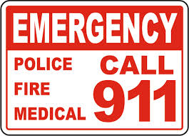
In an emergency situation:
Call 911.
Give your name, location, and reason for calling.
Explain the condition of the injured person.
Describe what help the injured person has received.
If you cannot call 911, have someone call.
Time is critical in emergency situations. Acting quickly and correctly can save someone’s life.

Slide 26
CPR AED Demonstration Video
http://www.youtube.com/watch?v=FyngKNdwNd8

