Slide 1
Personal Hygiene
Coach Mullen
7th Grade Health
Unit 4: Personal Health & Wellness

Slide 2
Health
According to the World Health Organization, health is a state of complete physical, mental and social well-being and not merely the absence of disease or infirmity.

Slide 3

Hygiene
  Hygiene: The actions you take to improve or maintain your health. (healthy habits)
Good hygiene prevents the spread of germs
It also helps to give a good first impression to others

Slide 4
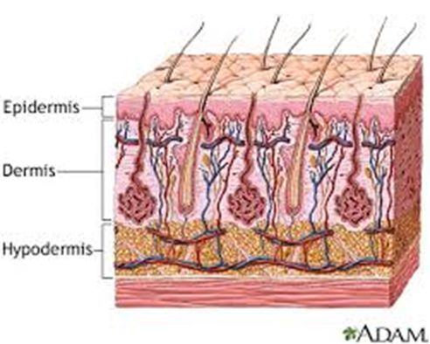
Healthy Skin
Your skin is the biggest organ of your body.
The two main layers of the skin are the epidermis and the dermis.
  Epidermis: The thinner outer layer of the skin
  Dermis: The thicker inner layer of the skin

Slide 5
Warm Up:
List at least three functions that your skin performs

Slide 6
What does our skin do?
Skin gives a sense of touch and temperature
It is your first line of defense against infection
It gets rid of water and salt through perspiration (also to cool your body)
Blood vessels in you skin allows the body to control its temperature
Skin uses energy from sunlight to make vitamin D

Slide 7
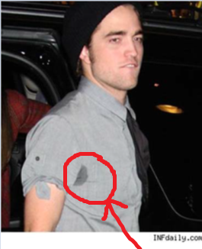
Sweating It Out
Don’t panic, though.
Sweat and smell are normal
parts of becoming an adult.
Sweating has an important job – it helps to cool your body down when you are hot.
You actually have two to four million sweat glands all over the body
Apocrine glands under the arms and in the groin secrete odors
But thanks to puberty, these glands not only become more active they also begin to secrete different chemicals into the sweat that has a strong smelling odor

Slide 8
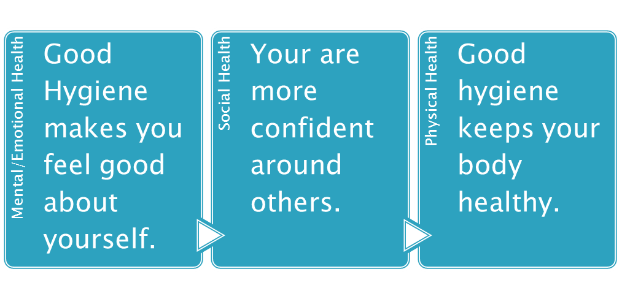
How do you know if you have unpleasant body odor?
1) Strange as it may seem, sometimes people with unpleasant body odor are unable to smell their body odor.
2) You may have an unpleasant smell if you do not shower or bathe at least once a day.
3) If you do not change clothes and undergarments daily.
4) Air out shoes and socks to avoid stinky feet. WEAR SOCKS!!!

Slide 9
Shower or take a bath every day.
Wearing clean clothes, socks, and underwear each day can also help you to feel clean.
If you sweat a lot, find clothes made from cotton or other natural materials will help absorb sweat more effectively.
If you're concerned about the way your underarms smell, you can try using a deodorant or deodorant with antiperspirant.
Deodorants get rid of the odor of sweat by covering it up
antiperspirants actually stop or dry up perspiration.
Remember: nothing smells better than clean skin. Perfumes are not a good substitute for a shower or wash.

Slide 10
Scoop on Skin Care
Acne often starts in your early teen years because your body is going through hormonal changes and producing more oil glands
A few different skin problems are a part of acne:
Blackhead: a widened hair follicle filled with skin debris, bacteria, and oil called sebum. A blackhead has a wide opening to the skin and is capped with a blackened mass of skin debris. In contrast, a closed comedo, commonly called a whitehead, has an obstructed opening to the skin and may rupture.
Cystic acne: plugged follicle breaks deep inside in the skin, nodules or cysts form

Slide 11
What can make acne worse?
Oil-based make-up, suntan oil, hair
gels, and sprays
Stress
Your period
Picking at your pimples
Scrubbing your skin too hard
Getting too much sun
The best way to do this is keep your face clean by washing your face twice a day with mild soap.

Slide 12
Myths About Acne
Myth #1: Tanning clears up skin.
Although a tan may temporarily mask acne, the sun can make the
skin dry and irritated, leading to more breakouts in the future
Myth #2: Chocolate and greasy foods cause acne
Although eating too many sugary, high-fat foods is never a good idea, studies show that NO SPECIFIC FOODS have been proven to cause acne.
Myth #3: The more you wash your face, the fewer breakouts you'll have
As a general rule, wash your face twice a day with mild soap and water in a circular motion and gently pat dry when you're done.

Slide 13
Myths About Acne
Myth #4: Popping pimples will help them go away faster
By squeezing pimples and zits, you can actually push bacteria, dead skin cells, and oil further into the skin.
Myth #5: Don't wear makeup if you want clear skin
As long as you choose cosmetics that are noncomedogenic, it’s ok.
Myth #6: If you keep getting breakouts, it helps to use more acne medication until the breakouts stop.
Because acne medication contains drying agents like benzoyl, peroxide and salicylic acid, using too much medication may cause over drying.

Slide 14
Get Healthy,
Gorgeous Hair
The same kind of oil that causes breakouts on your face also comes out of the pores on your scalp.
Wash regularly with shampoo
Massage your scalp well. This will remove dead skin cells, excess oil and dirt.
Rinse well with clean water.
When you're styling your hair, pay close
attention to the products you use.

Slide 15
Healthy Hair
The roots of the hair are in the dermis and are housed in pockets called follicles.
Two common hair and scalp problems are:
Dandruff- A condition that results when too many dead skin cells flake off the outer layer of the scalp
Head lice
-Do not share brush, comb, or hat

Slide 16
Health Teeth & Gums
Your teeth makes it possible for you to chew and break down food for digestion.
Your gums anchor your teeth in your mouth and keep them in place.
Remember you only have one set of adult teeth. This is why it’s important to take care of your teeth your entire life.

Slide 17
Bad Breath
Bad breath, also called halitosis
What causes cavities?
Sugar and Plaque together creates bacteria that causes tooth decay and cavities.
How to avoid tooth decay.
Brush your teeth (and tongue!) for at least 2 minutes twice a day with a fluoride toothpaste, especially after meals. Floss every day.
Replace your toothbrush every 3 to 4 months.
Visit your dentist every 6 months.
Buy dental hygiene products certified by the American Dental Association (ADA)

Slide 18

Bad Breath
Tooth decay begins with the formation of plaque.
Plaque: A soft, colorless, sticky film containing bacteria that grows on your teeth.
If plaque is not removed, it eventually hardens and becomes tarter.
When you brush, use a toothpaste that contains fluoride.
  Fluoride: A substance that fights tooth decay
You may be at higher risk for serious disease later in life, such as heart disease and stroke.
Bad breath is caused by the excretion of the anaerobic bacteria that live within your mouth. These anaerobic bacteria (bacteria that do not need oxygen to survive) excrete sulfur compounds.

Slide 19
Clean Hands, Please!
The single most important thing we can do to keep from getting sick and spreading illness to others is to clean our hands!
Hands are the easiest transporters of germs and bacteria.
Wash your hands with warm water and soap for at least 20 seconds. (Happy Birthday song TWICE).
2. You may need a brush to get under nails if they are dirty.
3. Use something clean to dry your hands, such as paper towel or a hot air dryer.
You should wash your hands thoroughly, especially after using the restroom, coughing, sneezing or handling food.
Hand Sanitizers –Use only when no access to sink
Notes:
Who’s Washing Their Hands and Who’s Not?
● In one study, only 58% of female and 48% of male middle and
high school students washed their hands after using the bathroom.
Of these, only 33% of the females and 8% of the males used soap.

Slide 20
Clean Hands Please!!!
-According to the Centers for Disease Control (CDC) 22 million school days are lost each year due to the common cold.
-Some viruses and bacteria can live from 20 minutes up to 2 hours or more on surfaces like cafeteria tables, doorknobs, and desks

Slide 21

Protection from the sun
Cancer researchers believe childhood sunburns may increase a person's risk of developing melanoma, the most serious skin cancer.
80% of the average person's lifetime sun exposure happens before age 18.
Skin cancer is the most common of all cancers. It accounts for nearly half of all cancers in the United States.

Slide 22
Warm Up:
List at least three functions of skin

Slide 23

Protection from the sun
Tips:
Put it on 15-20 minutes before going out in the sun.
Reapply after swimming, toweling dry, or perspiring.
Reapply every two hours
Use sunscreen even on hazy or overcast days.

Slide 24
Activity
http://www.ewg.org/skindeep/app/

Slide 25
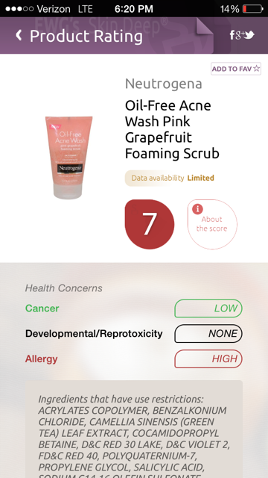

Slide 26
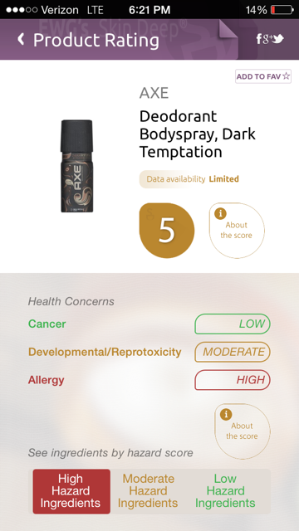

Slide 27
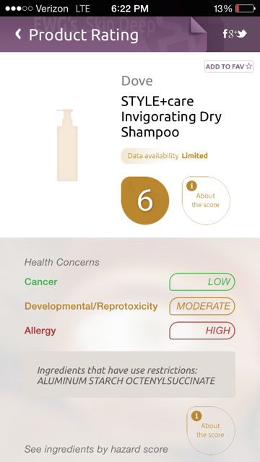

Slide 28
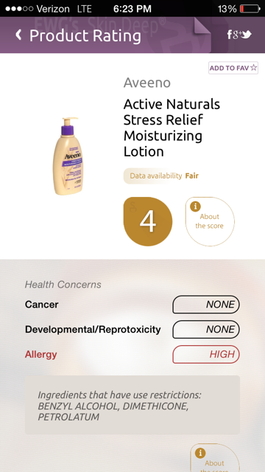

Slide 29
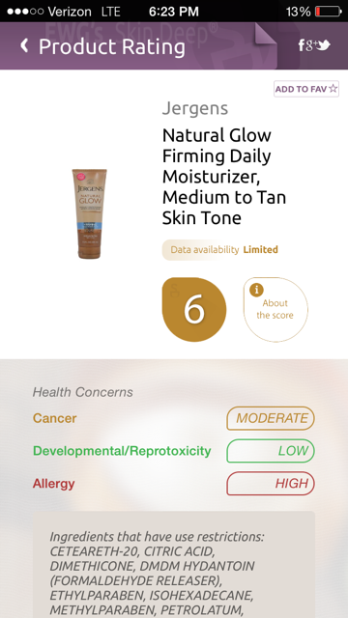

Slide 30
